Slide 1
The Life of Christ
Part 68

Slide 2
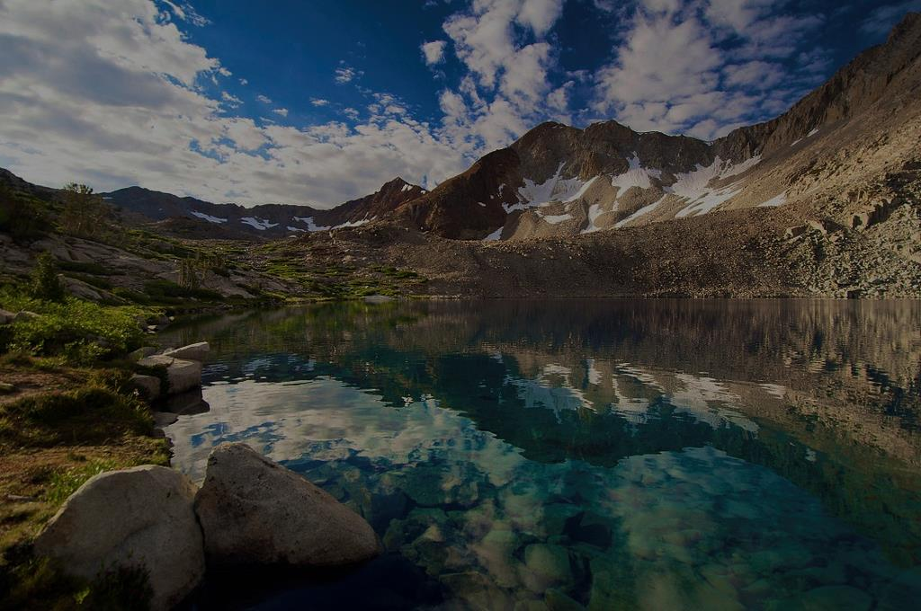
Luke 17:11 Now it happened as He went to Jerusalem that He passed through the midst of Samaria and Galilee. ¹² Then as He entered a certain village, there met Him ten men who were lepers, who stood afar off. ¹³ And they lifted up their voices and said, "Jesus, Master, have mercy on us!" ¹⁴ So when He saw them, He said to them, "Go, show yourselves to the priests." And so it was that as they went, they were cleansed. ¹⁵ And one of them, when he saw that he was healed, returned, and with a loud voice glorified God, ¹⁶ and fell down on his face at His feet, giving Him thanks. And he was a Samaritan.

Slide 3
¹⁷ So Jesus answered and said, "Were there not ten cleansed? But where are the nine? ¹⁸ "Were there not any found who returned to give glory to God except this foreigner?" ¹⁹ And He said to him, "Arise, go your way. Your faith has made you well."

Slide 4
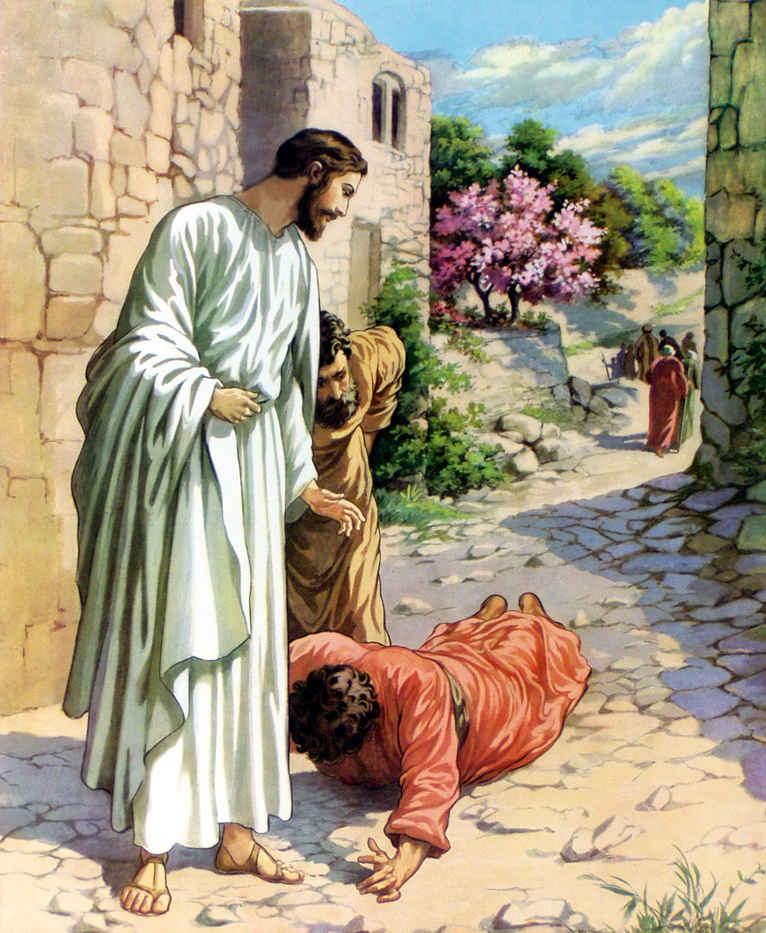

Slide 5
Luke 17:20 Now when He was asked by the Pharisees when the kingdom of God would come, He answered them and said, "The kingdom of God does not come with observation; ²¹ "nor will they say, 'See here!' or 'See there!' For indeed, the kingdom of God is within you." ²² Then He said to the disciples, "The days will come when you will desire to see one of the days of the Son of Man, and you will not see it. ²³ "And they will say to you, 'Look here!' or 'Look there!' Do not go after them or follow them. ²⁴ "For as the lightning that flashes out of one part under heaven shines to the other part under heaven, so also the Son of Man will be in His day.

Slide 6
²⁵ "But first He must suffer many things and be rejected by this generation. ²⁶ "And as it was in the days of Noah, so it will be also in the days of the Son of Man: ²⁷ "They ate, they drank, they married wives, they were given in marriage, until the day that Noah entered the ark, and the flood came and destroyed them all. ²⁸ "Likewise as it was also in the days of Lot: They ate, they drank, they bought, they sold, they planted, they built; ²⁹ "but on the day that Lot went out of Sodom it rained fire and brimstone from heaven and destroyed them all. ³⁰ "Even so will it be in the day when the Son of Man is revealed.

Slide 7
³¹ "In that day, he who is on the housetop, and his goods are in the house, let him not come down to take them away. And likewise the one who is in the field, let him not turn back. ³² "Remember Lot's wife. ³³ "Whoever seeks to save his life will lose it, and whoever loses his life will preserve it. ³⁴ "I tell you, in that night there will be two men in one bed: the one will be taken and the other will be left. ³⁵ "Two women will be grinding together: the one will be taken and the other left. ³⁶ "Two men will be in the field: the one will be taken and the other left." ³⁷ And they answered and said to Him, "Where, Lord?" So He said to them, "Wherever the body is, there the eagles will be gathered together."

Slide 8
1. Some believe that Jesus is talking about the destruction of Jerusalem.
2. Others believe that Jesus is talking about His second coming.

Slide 9
Isaiah 13:10 For the stars of heaven and their constellations Will not give their light; The sun will be darkened in its going forth, And the moon will not cause its light to shine. See Isa. 13:19-20

Slide 10
Ezekiel 32:7 When I put out your light, I will cover the heavens, and make its stars dark; I will cover the sun with a cloud, And the moon shall not give her light. ⁸ All the bright lights of the heavens I will make dark over you, And bring darkness upon your land,' Says the Lord GOD.

Slide 11
Matthew 24:29 " Immediately after the tribulation of those days the sun will be darkened, and the moon will not give its light; the stars will fall from heaven, and the powers of the heavens will be shaken.

Slide 12
Luke 17:20 Now when He was asked by the Pharisees when the kingdom of God would come, He answered them and said, "The kingdom of God does not come with observation; ²¹ "nor will they say, 'See here!' or 'See there!' For indeed, the kingdom of God is within you."

Slide 13
John 18:36 "My kingdom is not of this world. If My kingdom were of this world, My servants would fight, so that I should not be delivered to the Jews; but now My kingdom is not from here."

Slide 14
Luke 17:²² Then He said to the disciples, "The days will come when you will desire to see one of the days of the Son of Man, and you will not see it. ²³ "And they will say to you, 'Look here!' or 'Look there!' Do not go after them or follow them. ²⁴ "For as the lightning that flashes out of one part under heaven shines to the other part under heaven, so also the Son of Man will be in His day.

Slide 15
Jesus will come personally and visibly.
Acts 1:11 Men of Galilee, why do you stand gazing up into heaven? This same Jesus, who was taken up from you into heaven, will so come in like manner as you saw Him go into heaven."

Slide 16
He will come with a shout.
1 Thessalonians 4:16 For the Lord Himself will descend from heaven with a shout, with the voice of an archangel, and with the trumpet of God. And the dead in Christ will rise first.

Slide 17
Even those in the grave will hear Him.
John 5:28 "Do not marvel at this; for the hour is coming in which all who are in the graves will hear His voice

Slide 18
He will be accompanied by angels.
Matthew 25:31 " When the Son of Man comes in His glory, and all the holy angels with Him, then He will sit on the throne of His glory.

Slide 19
Luke 17:25 "But first He must suffer many things and be rejected by this generation.

Slide 20
Luke 17:26 "And as it was in the days of Noah, so it will be also in the days of the Son of Man: ²⁷ "They ate, they drank, they married wives, they were given in marriage, until the day that Noah entered the ark, and the flood came and destroyed them all. ²⁸ "Likewise as it was also in the days of Lot: They ate, they drank, they bought, they sold, they planted, they built; ²⁹ "but on the day that Lot went out of Sodom it rained fire and brimstone from heaven and destroyed them all. ³⁰ "Even so will it be in the day when the Son of Man is revealed.

Slide 21
2 Peter 3:10 But the day of the Lord will come as a thief in the night, in which the heavens will pass away with a great noise, and the elements will melt with fervent heat; both the earth and the works that are in it will be burned up. ¹¹ Therefore, since all these things will be dissolved, what manner of persons ought you to be in holy conduct and godliness, ¹² looking for and hastening the coming of the day of God, because of which the heavens will be dissolved, being on fire, and the elements will melt with fervent heat?

Slide 22
Luke 17:31 "In that day, he who is on the housetop, and his goods are in the house, let him not come down to take them away. And likewise the one who is in the field, let him not turn back. ³² "Remember Lot's wife. ³³ "Whoever seeks to save his life will lose it, and whoever loses his life will preserve it.

Slide 23
Luke 9:62 "No one, having put his hand to the plow, and looking back, is fit for the kingdom of God."

Slide 24
³³ "Whoever seeks to save his life will lose it, and whoever loses his life will preserve it.

Slide 25
Luke 9:23 Then He said to them all, "If anyone desires to come after Me, let him deny himself, and take up his cross daily, and follow Me. ²⁴ "For whoever desires to save his life will lose it, but whoever loses his life for My sake will save it. ²⁵ "For what profit is it to a man if he gains the whole world, and is himself destroyed or lost? ²⁶ "For whoever is ashamed of Me and My words, of him the Son of Man will be ashamed when He comes in His own glory, and in His Father's, and of the holy angels.

Slide 26
Luke 17:34 "I tell you, in that night there will be two men in one bed: the one will be taken and the other will be left. ³⁵ "Two women will be grinding together: the one will be taken and the other left. ³⁶ "Two men will be in the field: the one will be taken and the other left."

Slide 27
1 Thessalonians 4:17 Then we who are alive and remain shall be caught up together with them in the clouds to meet the Lord in the air. And thus we shall always be with the Lord.

Slide 28
Luke 17:37 And they answered and said to Him, "Where, Lord?" So He said to them, "Wherever the body is, there the eagles will be gathered together."

